Slide 1
Data Structure & Algorithm
Lecture 4: Recursive
Dr. Mohamed Ezz
Al-Azhar University

Slide 2
Agenda
Recursive Algorithms

Slide 3
Recursive algorithms
recursive algorithm: description for a way to solve a problem, that refers to itself
Show everything in a folder and all it subfolders:
  show everything in top folder
  show everything in each subfolder in the same manner
Look up a word in a dictionary:
  look up the word using the alphabetical ordering.
  if all words in the definition are known to you, stop.
  else, for each unknown word in the definition, look up that word

Slide 4
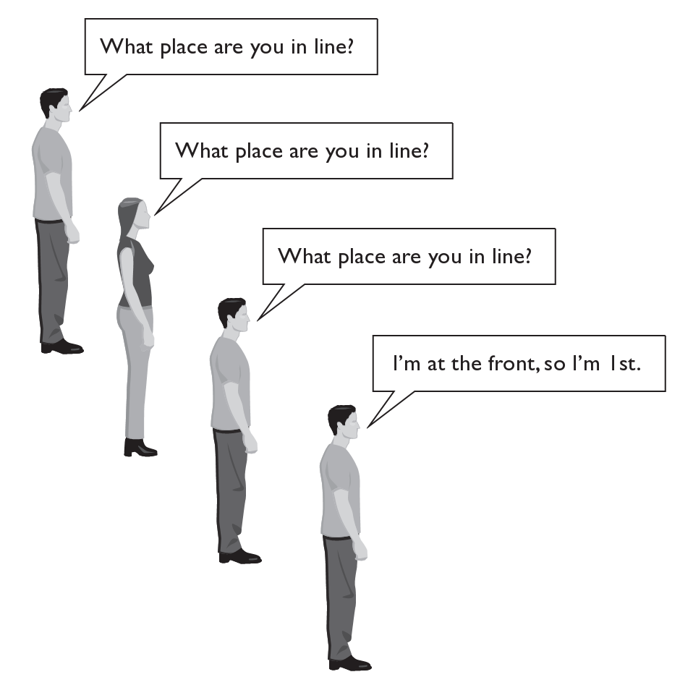
A recursive algorithm
Consider the task of finding out what place you are in a long line of people.
  If you cannot see the front of the line, you could ask the person in front of you.
  To answer your question, this person could ask the person in front of him/her, and so on.

Slide 5
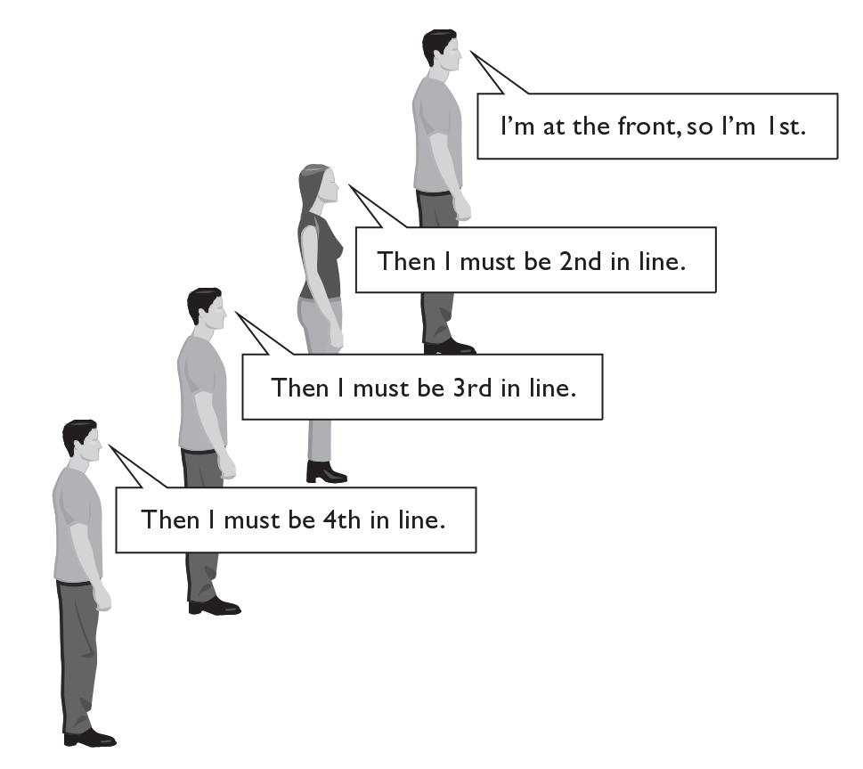
A recursive algorithm
Once the front person answers their place in line (first), this information is handed back, one person at a time, until it reaches you.
  This is the essence of recursive algorithms; many invocations of the same method each solve a small part of a large problem.

Slide 6
Recursive programming
A method in Java can call itself; if written that way, it is called a recursive method
A recursive method solves some problem.
The code of a recursive method should be written to handle the problem in one of two ways:
  base case: a simple case of the problem that can be answered directly; does not use recursion.
  recursive case: a more complicated case of the problem, that isn't easy to answer directly, but can be expressed elegantly with recursion; makes a recursive call to help compute the overall answer

Slide 7
Factorial example
The factorial for any positive integer N, written N!, is defined to be the product of all integers between 1 and N inclusive
// not recursive
public static long factorial(int n) {
long product = 1;
for (int i = 1; i <= n; i++) {
product *= i;
}
return product;
}

Slide 8
Recursive factorial
factorial can also be defined recursively:
A factorial is defined in terms of another factorial until the
basic case of 0! is reached
// recursive
public static long factorial(int n) {
if (n == 0) {
return 1;
} else {
return n * factorial(n - 1);
}
}

Slide 9

Recursive Algorithms Computer Implementation
long factorial(int n){
if (n==0) return 1;
return n*factorial(n-1);
}
Compute 5!

Slide 10
Recursive Algorithms Computer Implementation
long factorial(int n){
if (n==0) return 1;
return n*factorial(n-1);
}
f(5)=5·f(4)

Slide 11
Recursive Algorithms Computer Implementation
long factorial(int n){
if (n==0) return 1;
return n*factorial(n-1);
}
f(4)=4·f(3) | f(5)=5·f(4)

Slide 12
Recursive Algorithms Computer Implementation
long factorial(int n){
if (n==0) return 1;
return n*factorial(n-1);
}
f(3)=3·f(2) | f(4)=4·f(3) | f(5)=5·f(4)

Slide 13
Recursive Algorithms Computer Implementation
long factorial(int n){
if (n==0) return 1;
return n*factorial(n-1);
}
f(2)=2·f(1) | f(3)=3·f(2) | f(4)=4·f(3) | f(5)=5·f(4)

Slide 14
Recursive Algorithms Computer Implementation
long factorial(int n){
if (n==0) return 1;
return n*factorial(n-1);
}
f(1)=1·f(0) | f(2)=2·f(1) | f(3)=3·f(2) | f(4)=4·f(3) | f(5)=5·f(4)

Slide 15
Recursive Algorithms Computer Implementation
long factorial(int n){
if (n==0) return 1;
return n*factorial(n-1);
}
f(0)= 1→ | f(1)=1·f(0) | f(2)=2·f(1) | f(3)=3·f(2) | f(4)=4·f(3) | f(5)=5·f(4)

Slide 16
Recursive Algorithms Computer Implementation
long factorial(int n){
if (n==0) return 1;
return n*factorial(n-1);
}
1·1= 1→ | f(2)=2·f(1) | f(3)=3·f(2) | f(4)=4·f(3) | f(5)=5·f(4)

Slide 17
Recursive Algorithms Computer Implementation
long factorial(int n){
if (n==0) return 1;
return n*factorial(n-1);
}
2·1= 2→ | f(3)=3·f(2) | f(4)=4·f(3) | f(5)=5·f(4)

Slide 18
Recursive Algorithms Computer Implementation
long factorial(int n){
if (n==0) return 1;
return n*factorial(n-1);
}
3·2= 6→ | f(4)=4·f(3) | f(5)=5·f(4)

Slide 19
Recursive Algorithms Computer Implementation
long factorial(int n){
if (n==0) return 1;
return n*factorial(n-1);
}
4·6= 24→ | f(5)=5·f(4)

Slide 20
Recursive Algorithms Computer Implementation
long factorial(int n){
if (n==0) return 1;
return n*factorial(n-1);
}
5·24= 120→

Slide 21
Recursive Algorithms Computer Implementation
long factorial(int n){
if (n==0) return 1;
return n*factorial(n-1);
}
Return 5! = 120

Slide 22
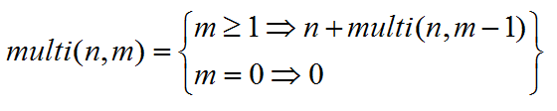
Another Example
Multiply number in processor consider a recursive addition:
A Multiply is defined in terms of another Multiply until the
basic case of m=0 is reached
// recursive
public static long multi (int n,int m) {
if (m == 0) {
return 0;
} else {
return n + multi (m - 1);
}
}

Slide 23
Recursive Algorithms Computer Implementation
public static long multi (int n,int m) {
if (m == 0) return 0;
else return n + multi (m - 1);
}
multi (5,3)

Slide 24
Recursive Algorithms Computer Implementation
public static long multi (int n,int m) {
if (m == 0) return 0;
else return n + multi (m - 1);
}
multi(5,0)=0 | multi(5,1)= 5+multi (5,0) | multi(5,2)= 5+multi (5,1) | multi(5,3)= 5+multi (5,2)

Slide 25
Recursive Algorithms Computer Implementation
public static long multi (int n,int m) {
if (m == 0) return 0;
else return n + multi (m - 1);
}
multi(5,1)= 5+0 | multi(5,2)= 5+multi (5,1) | multi(5,3)= 5+multi (5,2)

Slide 26
Recursive Algorithms Computer Implementation
public static long multi (int n,int m) {
if (m == 0) return 0;
else return n + multi (m - 1);
}
multi(5,2)= 5+5 | multi(5,3)= 5+multi (5,2)

Slide 27
Recursive Algorithms Computer Implementation
public static long multi (int n,int m) {
if (m == 0) return 0;
else return n + multi (m - 1);
}
multi(5,3)= 5+10

Slide 28
Recursive Algorithms Computer Implementation
public static long multi (int n,int m) {
if (m == 0) return 0;
else return n + multi (m - 1);
}
multi(5,3)=15

Slide 29
Recursion vs. iteration
every recursive solution has a corresponding iterative solution
  For example, N ! can be calculated with a loop
recursion has the overhead of multiple method invocations
however, for some problems recursive solutions are often more simple and elegant than iterative solutions
you must be able to determine when recursion is appropriate

Slide 30
Binary Search - iteration
  public static int find(long searchKey){
    int lowerBound = 0;
    int upperBound = nElems-1;
    int curIn;
    while(true)
    {
    curIn = (lowerBound + upperBound ) / 2;
    if(arr[curIn]==searchKey)
    return curIn; // found it
    else if(lowerBound > upperBound)
    return -1; // can’t find it
    else // divide range
    {
    if(arr [curIn] < searchKey)
    lowerBound = curIn + 1; // it’s in upper half
    else
    upperBound = curIn - 1; // it’s in lower half
    } // end else divide range
    } // end while
  }
} //end class

Slide 31
Binary Search - Recursion
private int recFind(long searchKey, int lowerBound, int upperBound)
{
int curIn;
curIn = (lowerBound + upperBound ) / 2;
if(arr[curIn]==searchKey)
return curIn; // found it
else if(lowerBound > upperBound)
return -1; // can’t find it
else // divide range
{
if(arr[curIn] < searchKey) // it’s in upper half
return recFind(searchKey, curIn+1, upperBound);
else // it’s in lower half
return recFind(searchKey, lowerBound, curIn-1);
} // end else divide range
} // end recFind()

